Slide 1
Modern Approach to Gaming Analysis
Analysis Beyond the Ranking Report
Brett Jones M.B.A
Bullseye CX

Slide 2
Key Focus Points
Where the Money At – Understanding Distribution
Theoretical Gaming Profit
Metrics that Matter ( look beyond the gaming system for metrics )
The New Groove – Lift and Clump
Floor Maps
Capital Budgeting
Try it, Measure It, Act Swiftly on It

Slide 3
Where the Money At ?
Understanding Distribution
Compares floor space occupied by a group of EGM’s that share a Common Characteristic against a Key Metric…. Basic yet effective
Common Characteristics can include ;
Denomination
Manufacturer
Location
Linked / Stand Alone
Multi Game
Key Metrics can include ;
Turnover
Profit
EGM Type
Time on Device
TGP

Slide 4
Where the Money At ?
Understanding Distribution
Compares floor space occupied by a group of EGM’s that share a Common Characteristic against a Key Metric.
Common Characteristics can include ;
Denomination
Manufacturer
Location
Linked / Stand Alone
Multi Game
Key Metrics can include ;
Turnover
Profit
EGM Type
Time on Device
TGP

Slide 5
Where the Money At ?
Understanding Distribution
Compares floor space occupied by a group of EGM’s that share a Common Characteristic against a Key Metric.
Common Characteristics can include ;
Denomination
Manufacturer
Location
Linked / Stand Alone
Multi Game
Key Metrics can include ;
Turnover
Profit
EGM Type
Time on Device
TGP

Slide 6
Where the Money At ?
Understanding Distribution
If 60% of our gaming floor is $0.01, and our $0.01 games provide 60% of Turnover and 60% of Profit, our $0.01 games are balanced.
If 25% of our gaming floor is Stand Alone, and our Stand Alone games provide 15% of Turnover and 15% of Profit, our Stand Alone Games are under performing and require attention.
If 50% of our gaming floor is Aristocrat, and Aristocrat provides 65% of Turnover and 60% of Profit, our Aristocrat Games are over performing and require attention.

Slide 7
Where the Money At ?
Understanding Distribution
If 60% of our gaming floor is $0.01, and our $0.01 games provide 60% of Turnover and 60% of Profit, our $0.01 games are balanced.
If 25% of our gaming floor is Stand Alone, and our Stand Alone games provide 15% of Turnover and 15% of Profit, our Stand Alone Games are under performing and require attention.
If 50% of our gaming floor is Aristocrat, and Aristocrat provides 65% of Turnover and 60% of Profit, our Aristocrat Games are over performing and require attention.

Slide 8
Where the Money At ?
Understanding Distribution
If 60% of our gaming floor is $0.01, and our $0.01 games provide 60% of Turnover and 60% of Profit, our $0.01 games are balanced.
If 25% of our gaming floor is Stand Alone, and our Stand Alone games provide 15% of Turnover and 15% of Profit, our Stand Alone Games are under performing and require attention.
If 50% of our gaming floor is Aristocrat, and Aristocrat provides 65% of Turnover and 60% of Profit, our Aristocrat Games are over performing and require attention.

Slide 9
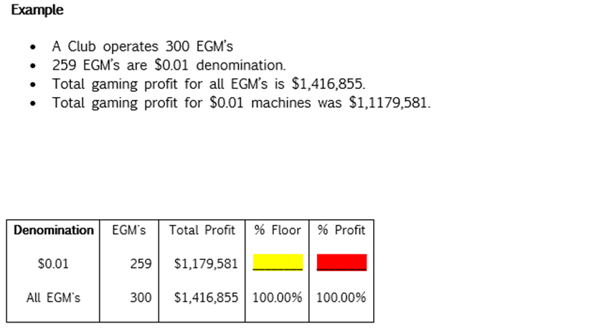
Where the Money At ?
Understanding Distribution
What does this tell as about our $0.01 games?
What action can we take ?

Slide 10
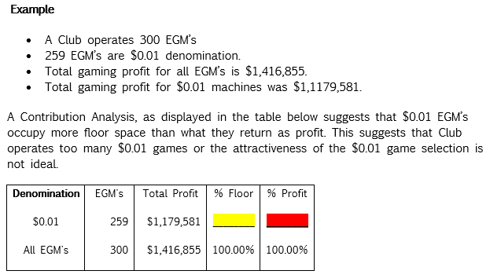
Where the Money At ?
Understanding Distribution
What does this tell as about our $0.01 games?
What action can we take ?
86 %
82 %

Slide 11
Understanding
Theoretical Gaming Profit
Applies the Theoretical RTP% against the Turnover of an individual machine
Removes the cyclical impact of the gaming machine
Provides a better reflection of game performance

Slide 12
Understanding
Theoretical Gaming Profit
Applies the Theoretical RTP% against the Turnover of an individual machine
Removes the cyclical impact of the gaming machine
Provides a better reflection of game performance

Slide 13
Understanding
Theoretical Gaming Profit
Applies the Theoretical RTP% against the Turnover of an individual machine
Removes the cyclical impact of the gaming machine
Provides a better reflection of game performance

Slide 14
Understanding
Theoretical Gaming Profit

Slide 15
Understanding
Theoretical Gaming Profit
Based upon Profit, what would rank #1 in a Ranking Report

Slide 16
Understanding
Theoretical Gaming Profit
Based upon Turnover, what would rank #1 in a Turnover Report

Slide 17
Understanding
Theoretical Gaming Profit
Theoretical Gaming Profit is the most useful metric

Slide 18
Modern Metrics that Matter
Carded Play
Measuring Un Carded Play
Active Player Count
Footfall Strike Rate
Theo Win Per Day
Time on Device
Gaming Diversity

Slide 19
Modern Metrics that Matter
Carded Play
Measuring Un Carded Play
Active Player Count
Footfall Strike Rate
Theo Win Per Day
Time on Device
Gaming Diversity

Slide 20
Modern Metrics that Matter
Carded Play
Measuring Un Carded Play
Active Player Count
Footfall Strike Rate
Theo Win Per Day
Time on Device
Gaming Diversity

Slide 21
Modern Metrics that Matter
Carded Play
Measuring Un Carded Play
Active Player Count
Footfall Strike Rate
Theo Win Per Day
Time on Device
Gaming Diversity

Slide 22
Modern Metrics that Matter
Carded Play
Measuring Un Carded Play
Active Player Count
Footfall Strike Rate
Theo Win Per Day
Time on Device
Gaming Diversity

Slide 23
Modern Metrics that Matter
Carded Play
Measuring Un Carded Play
Active Player Count
Footfall Strike Rate
Theo Win Per Day
Time on Device
Gaming Diversity

Slide 24
Modern Metrics that Matter
Carded Play
Measuring Un Carded Play
Active Player Count
Footfall Strike Rate
Theo Win Per Day
Time on Device
Gaming Diversity

Slide 25
Modern Metrics that Matter
Carded Play
Measuring Un Carded Play
Active Player Count
Player Per Visit
Footfall Strike Rate
Theo Win Per Day
Time on Device
Gaming Diversity

Slide 26
Metrics that Matter
Carded Play ( Lead )
Measuring Un Carded Play ( Lead )
Active Player Count ( Lag )
Player Profit Per Visit ( Lag )
Footfall Strike Rate ( Lead )
Theo Win Per Day ( Lag )
Time on Device ( Lag )
Product Diversity ( Lead )
Lag Indicators
Lead Indicators

Slide 27
The New Groove
Lift and Clump
Lift is the additional revenue derived by the venue with the introduction of new gaming product
Lift calculates the new money
Lift looks at the correlation between visitations, time on device and TGP over time

Slide 28
The New Groove
Lift and Clump
Clumping EGM’s is a contemporary practice
Clumping involves placing together, or “clumping,” highly volatile games with less volatile games to provide players with more time on device(s).
Particularly useful given high mix of SAP and Linked products.
Anecdotally, player time in venue increases

Slide 29
Interactive Floor Plan
Combines multi-variables
Easy to view
Can bring in as many metrics as you like
Be attracted to functionality and not distracted by attractiveness
See sample floor plan

Slide 30
Capital Budgeting
Boards to commit to an annual budget at start of year
Buy on performance, not on price
Set performance KPI’s early, and monitor
Act swiftly on warranty
Best practice is to turn gaming floor over every 5 years

Slide 31
Capital Budgeting
Boards to commit to an annual budget at start of year
Buy on performance, not on price
Set performance KPI’s early, and monitor
Act swiftly on warranty
Best practice is to turn gaming floor over every 5 years

Slide 32
Capital Budgeting
Boards to commit to an annual budget at start of year
Buy on performance, not on price
Set performance KPI’s early, and monitor
Act swiftly on warranty
Best practice is to turn gaming floor over every 5 years

Slide 33
Capital Budgeting
Boards to commit to an annual budget at start of year
Buy on performance, not on price
Set performance KPI’s early, and monitor
Act swiftly on warranty
Best practice is to turn gaming floor over every 5 years

Slide 34
Capital Budgeting
Boards to commit to an annual budget at start of year
Buy on performance, not on price
Set performance KPI’s early, and monitor
Act swiftly on warranty
Best practice is to turn gaming floor over every 5 years

Slide 35
Summary
Create set of metrics that work for you
Measure the metrics regularly
Avoid Paralysis by Analysis
Try new things
Act swiftly

